Slide 1
Data Analytics in Student Success
DAI Final Capstone
Evelyn Davis

Slide 2
ABOUT ME
Name
Evelyn Davis
Background
Job
Curriculum Developer
Sergeant in the United States Space Force
Trained computer system programmer
Develop curriculum for cyber career field
Degrees in computer science and math
Interests
Travel
Sport
Health
Music
Art
Tech
Notes:
As a curriculum developers, It's important to know and understand how to best train our airman.

Slide 3
MOTIVATION
Purpose?
AETC mission:
Recruit, train, and educate exceptional Airmen.
Train and Educate in the Air Force:
Student academic performance factors
Behavioral analysis.
Improve training and education.
Notes:
Motivation and elevator pitch:
As a curriculum developer, my mission is to support the Air Force Education and Training Command. We are focusing on recruiting, train, and educating exceptional Airmen. What are the factors of the student's academic performance? Is there a relationship between students’ behavioral features? How can we improve our training and education in the department of the Air Force? In this capstone, I will use data virtualization and statistical tools to review some of the key factors affecting students’ success and how to improve our students’ performance in training.

Slide 4
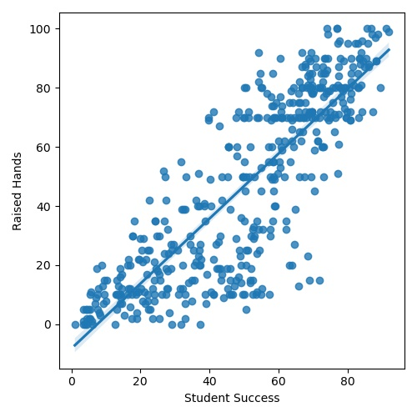
RAISED HANDS
Slope: 0.6453
R-square: 0.7087
P-value: 4.2226e^-130
Standard Error: 0.0189
Notes:
The data is collected using a learner activity tracker tool, which called experience API (xAPI). The xAPI is a component of the training and learning architecture (TLA) that enables to monitor learning progress and learner’s actions like reading an article or watching a training video.
The dataset consists of 480 student records and 16 features. The features are classified into three major categories: (1) Demographic features such as gender and nationality. (2) Academic background features such as educational stage, grade Level and section. (3) Behavioral features such as raised hand on class, opening resources, answering survey by parents, and school satisfaction.

Slide 5
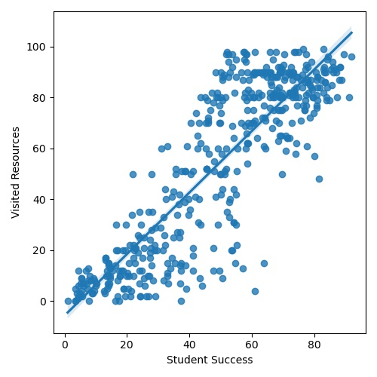
VISITED RESOURCES
Slope: 0.6142
R-square: 16.3964
P-value: 1.2671e^-142
Standard Error: 0.0166
Notes:
The data is collected using a learner activity tracker tool, which called experience API (xAPI). The xAPI is a component of the training and learning architecture (TLA) that enables to monitor learning progress and learner’s actions like reading an article or watching a training video.
The dataset consists of 480 student records and 16 features. The features are classified into three major categories: (1) Demographic features such as gender and nationality. (2) Academic background features such as educational stage, grade Level and section. (3) Behavioral features such as raised hand on class, opening resources, answering survey by parents, and school satisfaction.

Slide 6
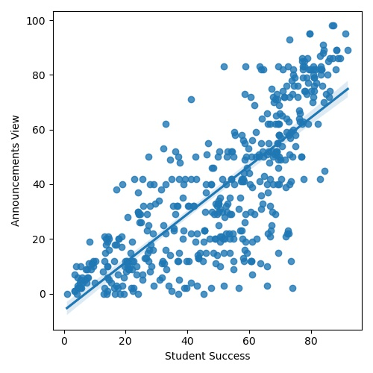
ANNOUNCEMENTS VIEW
Slope: 0.6923
R-square: 23.8060
P-value: 1.02844e^-99
Standard Error: 0.0253
Notes:
The data is collected using a learner activity tracker tool, which called experience API (xAPI). The xAPI is a component of the training and learning architecture (TLA) that enables to monitor learning progress and learner’s actions like reading an article or watching a training video.
The dataset consists of 480 student records and 16 features. The features are classified into three major categories: (1) Demographic features such as gender and nationality. (2) Academic background features such as educational stage, grade Level and section. (3) Behavioral features such as raised hand on class, opening resources, answering survey by parents, and school satisfaction.

Slide 7
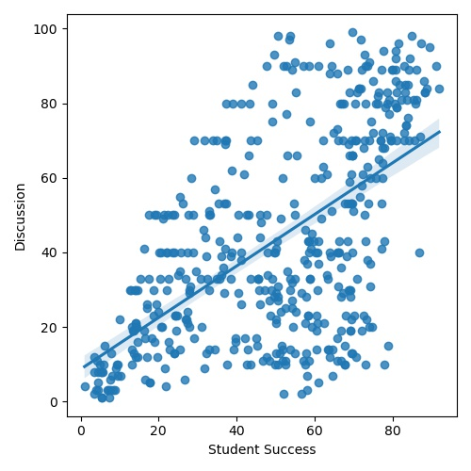
DISCUSSION
Slope: 0.5036
R-square: 28.2560
P-value: 2.3863e^-46
Standard Error: 0.0315
Notes:
The data is collected using a learner activity tracker tool, which called experience API (xAPI). The xAPI is a component of the training and learning architecture (TLA) that enables to monitor learning progress and learner’s actions like reading an article or watching a training video.
The dataset consists of 480 student records and 16 features. The features are classified into three major categories: (1) Demographic features such as gender and nationality. (2) Academic background features such as educational stage, grade Level and section. (3) Behavioral features such as raised hand on class, opening resources, answering survey by parents, and school satisfaction.

Slide 8
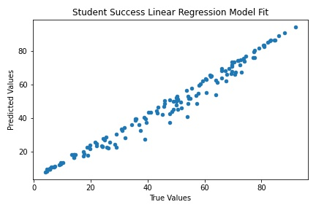
LINEAR REGRESSION
Raised Hands
Student success increase 6.6377 for each raised hands
Visited Resources
Student success increase 11.2121 for each time visit a course content
6.6377
Announcements View
11.2121
Student success increase 4.7097 for each time check the new announcements
Coefficients
4.7097
Discussion
6.6834
Student success increase 6.6834 for each time participate on discussion groups

Slide 9
SUMMARY SUGGESTION
Activities
Evaluation
Feedback
Create more group activities
Record and encourage students to visit more course content
Students
Give valuable feedback to students in class
Monitor students’ behaviors progress
Extra point for each time student checks the new announcements
Encourage student engagement in class
Observations
Grades

Slide 10
FUTURE WORK
More data: The original data only has 480 instance and 16 attributes, collecting more data could improve accuracy.
Hypothesis testing: Welch two sample T-test, and Chi-squared test to see if student behaviour differ by demographic features.

Slide 11

THANKS
CREDITS: This presentation used graphic designs provided by Slidesgo, including icons by Flaticon, and infographics & images by freepik
Do you have any questions?
evelyn.davis.1l@spaceforce.mil
+1 228-377-0651
spaceforce.mil

Slide 12
TABLE OF CONTENTS
ABOUT ME
01
MOTIVATION
02
VIRTUALIZATION
03
STATISTICAL RESULTS
04
CONCLUSION
05
Background, job, interests
Purpose of the project, how important for the military
Data structure, and figures, virtualizing data
linear regression, logistic regression
Summary and future work

Slide 13
Regression Coefficients
Linear
Ridge
Lasso
Raised Hands
6.6368
6.5031
6.6184
Visited Resources
11.2121
8.7145
11.1561
Announcements View
4.7097
5.1695
4.6819
Discussion
6.6834
5.4469
6.6125
R^2
0.9771
0.9568
0.9768

Slide 14
SUMMARY
Demographic
Modeling
01
04
02
03
Parents Relations
Behavioural
US students stand in the middle with large standard deviation among other countries by student performance
Linear regression: R^2 0.9771
Logistic regression: ROC 88.5%
Students loser to Mother has better performance
Raise more hand, visited more resources, viewing more announcements, and discuss more in groups

